Slide 1
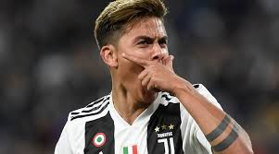
Paulo Dybala

Slide 2
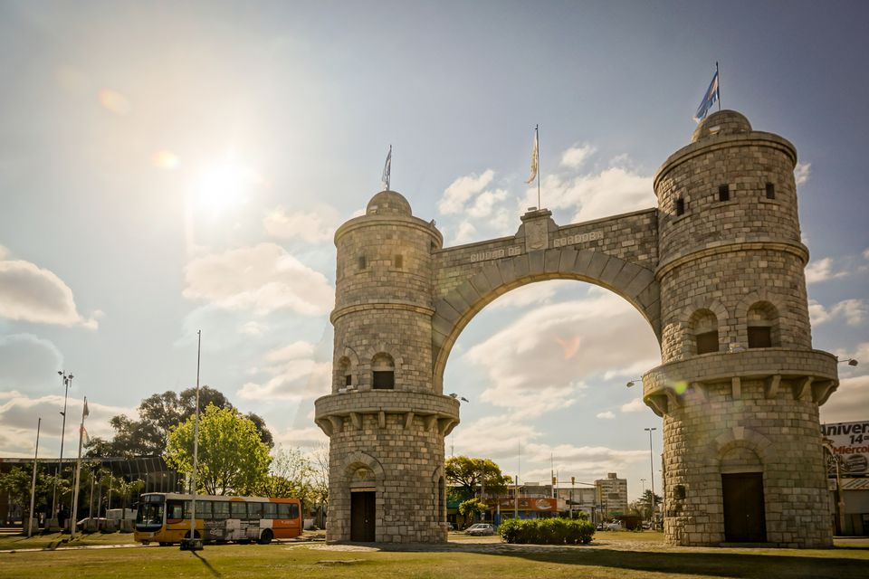
Young Stages
Paulo Dybala was born in Argentina on the 15 November 1993.
Paulo Dybala was born in Laguna Larga, in Córdoba, Argentina.

Slide 3
Career
Paulo Dybala is a professional footballer
He plays for Juventus witch is an Italian football team.
https://www.youtube.com/watch?v=ExN51V7sa50

Slide 4
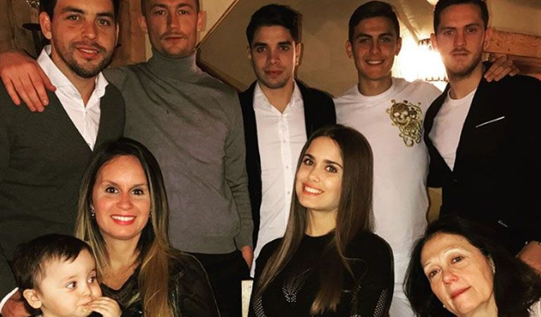
Lifestyle
His mother was called Alicia De Dybala
His father was called Adolfo Dybala
His brother was called Mariano Dybala
His brother was called Gustavo Dybala

